Slide 1
THE INTERSECTION OF IMMIGRATION &
CRIMINAL LAW IN NEW YORK
AN OVERVIEW
Joanne Macri, Esq.
International Centre for Criminal Law Reform and Criminal Justice Policy
macri@allard.ubc.ca
716.913.3200
Northern District of New York
March 28, 2019
Notes:
“The impact of deportation upon the life of an alien is often as great if not greater
than the imposition of a criminal sentence. A deported alien may lose his family,
his friends and his livelihood forever. Return to his native land may result in
poverty, persecution and even death.” Bridges v. Wixon, 326 U.S. 135, 164
(1945).

Slide 2
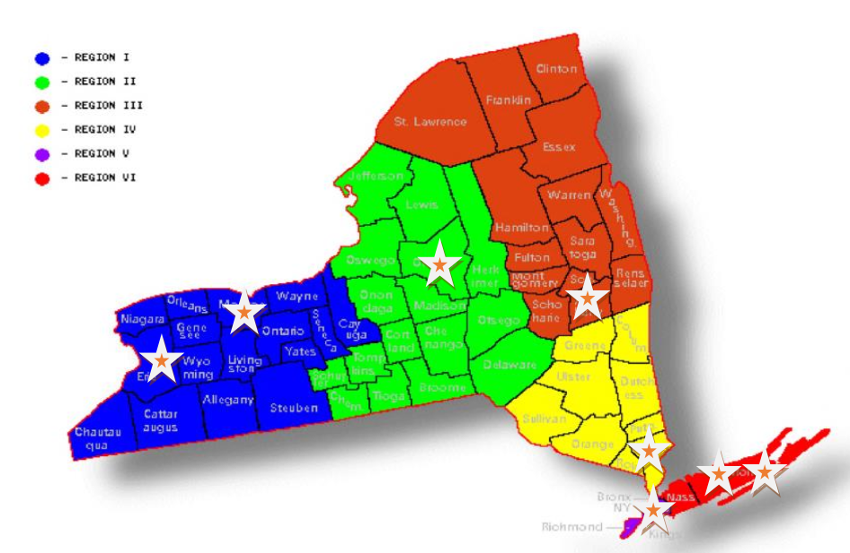
MISSION
Provide Legal Assistance and Support
Provide Continuing Legal Education and other Trainings
Development of Immigration Service Plans, Protocol and Procedures
Encourage Collaboration
Compliance with ILS standards
REGIONAL IMMIGRATION
ASSISTANCE CENTERS

Slide 3
Impacted Populations of
Immigration Consequences
Notes:
SECTION HEADER

Slide 4
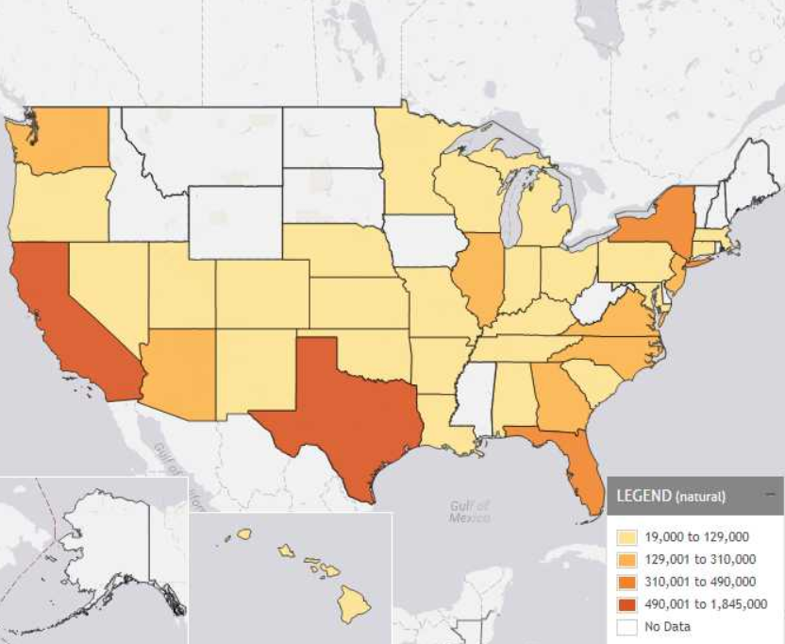
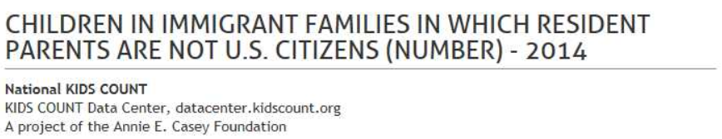
IMPACTED POPULATION
Of the 70 million children under age 18 in the United States,
26% (18.2 million) live with at least one immigrant parent
(Migration Policy Institute, Children in U.S. Immigrant Families)
Nearly 16 million of these children were born in the U.S.
More than 5 million children in the U.S. have at least one undocumented parent
  79% are U.S. citizens
  19% are undocumented
  2% are lawfully present non-citizens
Migration Policy Institute, Children in U.S. Immigrant Families (2016 Statistics)
In 2014, it was estimated that over 2,000,000/19.75 million
are reported non-citizens residing in New York State.
(www.migrationpolicy.org)

Slide 5
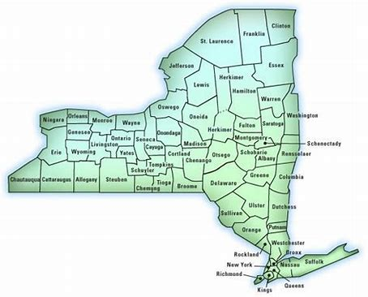
IMPACTED POPULATION*
Nearly ¼ of New York residents are immigrants.
Nearly three in five immigrants in New York are naturalized U.S. citizens.
1/5th of U.S. citizens have at least one immigrant parent.
Over half a million U.S. citizens in New York live with at least one family member who is undocumented.
New York is home to over 28,000 Deferred Action for Childhood Arrivals (DACA) (a.k.a. “Dreamers) recipients.
*Immigrants In New York. American Immigration Council (2020) available at
file:///C:/Users/17169/Desktop/Trainings/NYND%20Federal%20Training/immigrants_in_new_york.pdf

Slide 6
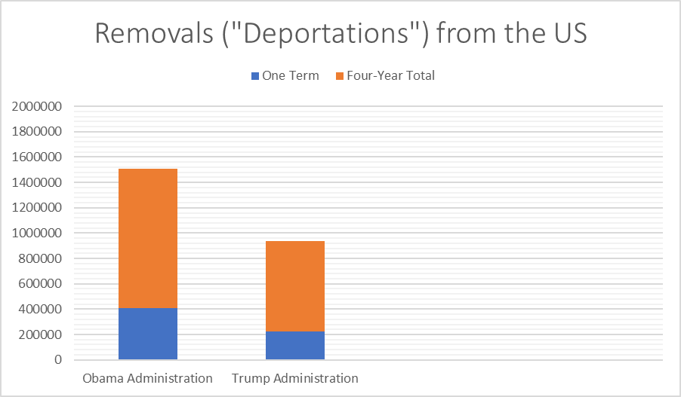
Deportations/Removals
Based on Criminal Conviction
*86% + arrested
by DHS in 2020
*In 2020, 86% of those arrested and charged with removal by the US Department of Homeland Security
had criminal convictions or criminal charges pending.

Slide 7
WHO IS SUBJECT TO
REMOVAL?
ANYONE WHO IS
NOT A U.S. CITIZEN
Notes:
USC – United States Citizen (USC) (born or naturalized) in the US or its incorporated territories or has derived citizenship (i.e., “derivative citizenship”) in which she is born outside the US to one or both parents who are USC. Special provisions apply to children adopted by a USC. (Child Citizenship Act - 8 U.S.C. § 1431 (a) and Child adopted by a USC parent – 8 U.S.C. § 1431(b)).
BEWARE OF “DENATURALIZATION” for those who obtained citizenship through naturalization.
(Ex. United States v. Suarez, 664 F.3d 655, 662 (7th Cir. 2011) (federal crime), holding that naturalized citizen, who committed drug offense during the statutory period prior to taking the oath but was indicted, arrested, and convicted after naturalization was subject to denaturalization and explaining that “we think it highly unlikely that Congress intended for applicants who, during the statutory
period, commit crimes that would disqualify them from naturalization to nonetheless slide through the loophole Suarez asks us to create if they manage to evade detection and conviction until after they are naturalized”).
Denaturalization Practice Tip: Qualification is a defense.
Maslenjak v. United States, 137 S.Ct. 1918 (2017), Holding that “the Government must establish that an illegal act by the defendant played some role in her acquisition of citizenship” and that “Section 1425(a) is not a tool for denaturalizing people who, the available evidence indicates, were actually qualified for the citizenship they obtained.”

Slide 8
WHO CAN BE REMOVED?
Lawful Permanent Resident
Admitted to the U.S. as a green card holder
Undocumented
Entered the United States illegally
(i.e., without being inspected and admitted)
Refugee or Asylee
Nonimmigrant
Humanitarian Relief
Granted refugee status outside of the U.S. or asylum status from within the U.S.
Admitted to the U.S. on a temporary basis
(i.e., to visit, attend school, work, etc.)
Granted temporary protection within the U.S. (i.e., TPS, DACA, T, U or S visa, etc.)
Notes:
It's important to know the individual’s immigration status, duration in the U.S., immigration current and prior history, prior departures from the U.S. and any information regarding immediate US family, (i.e., US citizen children, spouses and parents) because the criminal conviction will directly impact her chances of remaining in the United States and the length of time she may have to remain in the U.S.
Lawful Permanent Resident or Green Card Holder (LPR) - For the process, see 8 U.S.C. §§ 1151-59
LPRs are authorized to live and work in the US on a permanent basis BUT are subject to being
removed from the US for violating certain laws.
Refugees and Asylees
i. Refugees are admitted to the US from an outside country
ii. Asylees apply for and receives asylum from within the US
Nonimmigrants (e.g. tourist visa holder) are for temporary visitors to the US; they must
apply for a visa and be issued one. Other examples include, but are not limited to, a variety of temporary employment visas, (i.e., H-1B specialized skilled worker; TN NAFTA, L-1 Intracompany Transferee), au pairs; business visitors; crew members; foreign nationals with extraordinary ability in science, arts, education, business or athletics; journalists; religious workers; students; tourists; etc.
Humanitarian Relief categories include, but are not limited to, TPS – Temporary Protected Status, DACA – Deferred Action for Childhood Arrivals, S visa – Informants, T visa – Victims of Trafficking, U visa, VAWA victims, etc.)
Undocumented (EWI) – “Entry without inspection”

Slide 9
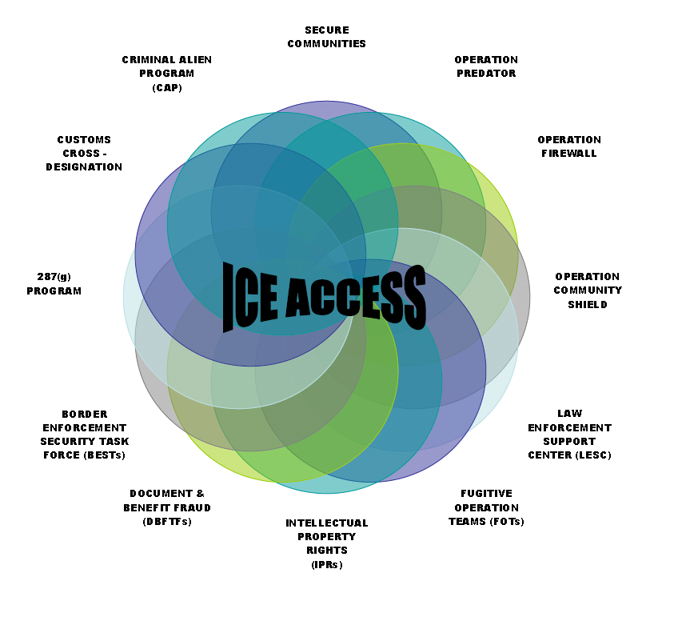
ICE ACCESS = AGREEMENTS OF COOPERATION IN COMMUNITIES
TO ENHANCES SAFETY AND SECURITY
**
Notes:
ICE ACCESS consists of a number of collaborative programs between the DHS and local, state and federal law enforcement to identify, arrest and detain any individual in violation of US immigration laws – particularly those related criminal involvement.
** US v. Wilson, Docket No. 11–915, 2nd Cir., (decided on10/25/12) is a Second Circuit case supporting the Customs Cross-Designation of local police officers. (Additional information available in Slide 12 notes).

Slide 10
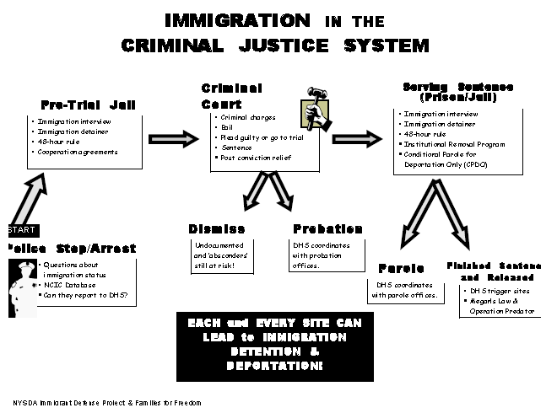
IMMIGRATION ISSUES IN CRIMINAL COURT
(New York State)
ICE DETAINER/HOLD
&
POSTING BAIL/RELEASE
NYS DOCCS IRP, APPEALS, POST-CONVICTION MTS & IRP PGM
BENCH WARRANTS, BOND REVOCATION
& SPEEDY TRIAL MOTIONS
4TH AMENDT
DHS
LOCAL/STATE
COLLABORATIVE
ICE TRANSFER
ECDPO,
ICE TRANSFER & EXPEDITED REMOVAL
Notes:
Department of Homeland Security can secure involvement in ach stage of the criminal justice process. However, note that, on April 17, 2019, the New York State Office of Court Administration (OCA) issued a new directive governing U.S. Immigration and Customs Enforcement (ICE) agents’ activities within New York State courthouses. (See subsequent information).

Slide 11
IMMIGRATION ISSUES IN CRIMINAL COURT
(Federal)
BOP and then transfer to DHS custody – often in the same federal facility.
ICE DETAINER/HOLD
&
POSTING BAIL/RELEASE
4TH AMENDT
DHS
LOCAL/STATE
COLLABORATIVE
ICE TRANSFER often not required while detained in federal holding facility such as BFDF in Batavia, NY.
*Judicial Order of Deportation pursuant to 8 USC §1252a(d)(1)
Notes:
Note: Stops/Search and Seizure
US v. Wilson, Docket No. 11–915, 2nd Cir., 10/25/12, two officers of the SRMPD, (tribal police department for the St. Regis Mohawk tribe) deemed “cross customs officers as designated by DHS) stopped and searched a vehicle near the St. Regis reservation which resulted in the discovery of drugs. At the time, the officers violated the DHS regulations specified by their cross designation as customs officers. Second Circuit found that the District Court erred in granting a motion to suppress because the violation of the ICE Directive, deemed “an internal agency policy” by the court, did not give rise to a Fourth Amendment violation.
People v. Page, 35 NY3d 199, 2020 NY Slip Op 03265 (2020), federal Customs and Border Protection (“CBP”) agent pulled over an erratic and arguably dangerous driver by utilizing emergency lights in the grille of his unmarked truck. There appeared to have been a number of VTL violations committed. After pulling over defendant’s vehicle, the CBP agent waited in his truck until a Buffalo Police Department (“BPD”) officer arrived. The BPD officer and the CBP agent approached the defendant’s vehicle together, with the CBP agent only observing (and not interacting with) the driver. The CBP agent left the scene after other BPD officers arrived. After the CBP agent had left, the BPD recovered a gun from the defendant’s vehicle following a search. defendant moved to suppress, arguing that: (1) the CBP agent was not vested with peace officer powers under CPL 140.25, and the arrest was outside of his geographic area of employment, and not acting under color of law, and (2) the stop was not a valid citizen’s arrest because emergency lights were used by the CBP to effectuate the vehicle stop. See People v Williams, 4 NY3d 535 [2005]. The NYS Court of Appeals held that the CBP agent was not a peace officer and thus, his actions could not have improperly circumvented the jurisdictional limitations on the powers of a “peace officer” special duties. Therefore, CPL 140.25 was not violated, thereby upholding the stop as lawful.
Note: *8 U.S.C. § 1252a(d)(1), provides that a United States District Court can enter a judicial order of deportation at the time of sentencing against an alien whose criminal conviction causes such alien to be deportable under 8 U.S.C. § 1251(a)(2)(A). Imperative to seek full immigration consultation prior to advising in favor of seeking a judicial order of deportation from a US District Court judge.

Slide 12
OCA Directive
Limiting ICE Arrests in New York State Courts
On April 17, 2019, the New York State Office of Court Administration (OCA) issued a new directive governing U.S. Immigration and Customs Enforcement (ICE) agents’ activities within New York State courthouses.
The new directive provides that ICE agents may execute arrests inside a New York State courthouse only if the arrest is pursuant to a judicial warrant or judicial order, issued by a federal judge or magistrate.
(N.B.: Does not apply to federal and town and village courts and does not prevent arrests “outside” of the courthouse doors)
Notes:
NOTE: The OCA directive does not prevent ICE agents from securing outdoor areas of the courthouse (i.e., parking lot, side walks, etc.) to secure the arrest of an individual.

Slide 13
WHAT IS AN IMMIGRATION DETAINER (FORM I-247)?
IMMIGRATION DETAINER is a “hold” that will prevent a client’s release.
Pursuant to 8 C.F.R. Sec. 287.7(a):
“… is a request that such agency advise the Department, prior to release of the alien, in order for the Department to arrange to assume custody, in situations when gaining immediate custody is either impracticable or impossible.” (emphasis added)
Notes:
Before seeking release of an immigrant client from state or local custody, determine whether they will be released to the community or transferred to ICE custody.
Confirm that your client is subject to removal from the US - ICE only has authority to detain immigrants who are removable from the U.S., (i.e., such as people who are undocumented or have overstayed a visa or are LPRS with prior deportable convictions). Those are not subject to removal will not be transferred to ICE custody, (i.e., LPR with no prior criminal history or history of immigration violations).
Confirm whether there are any warrants lodged against the individual, (i.e., this will include immigration holds/detainers). ICE notifies jails and prisons of their intention to take a client into custody by lodging a detainer request with the custodial agency. This may be indicated in the online “look up” system run by the local arresting agency, it may have been announced as a “hold” during the arraignment, or it may be disclosed if you ask the custodial agency if there are any “holds or warrants” for your client. (Note: In NYS, it is illegal for local jails and state prisons to hold immigrants for additional time based solely on a detainer request. See People ex rel. Wells v. DeMarco, 168 A.D.3d 31, 88 N.Y.S.3d 518 (N.Y. App. Div. 2018).
Confirm whether your jurisdiction has authority to communicate with ICE. For instance, in NYC, NYC DOC may only provide information about release dates and times to ICE about clients convicted of certain felonies in the past five years. (See New York City’s Detainer Discretion Law, consult the Chart and Practice Advisory by Cardozo Law Kathryn O. Greenberg Immigration Justice Clinic and the Immigrant Defense Project available at: https://www.immigrantdefenseproject.org/wp-content/uploads/2013/09/Practice-Advisory-2014-Detainer-Discretion-Law-PEP.pdf for more information.)

Slide 14
ICE “HOLDS” ARE NOT MANDATORY
“While immigration detainers are an important part of ICE’S effort to remove criminal aliens who are in Federal, state or local custody, they are not mandatory as a matter of law.”
Letter to Congressman Mike Thompson (CA -5th District)
From ICE Deputy Director, Daniel Ragsdale
February 25, 2014
See also Liranzo v United States (690 F3d 78, 82 [2d Cir 2012]) ;
Galarza v Szalczyk (No. 12-3991, 2014 US App LEXIS 4000 [3d Cir 3/4/14]);
Miranda-Olivares v. Clackamas County, 2014 WL 1414305 (D. Or.)
Notes:
PRACTICE TIP: ARGUING BAIL FOR A NONCITIZEN: If issues are raised that a bail in a criminal proceeding should be denied to ensure appearance of a noncitizen to any subsequent immigration hearing – defense counsel should be prepared to address whether removal proceedings were inevitable pending resolution of the pending criminal matter, (i.e., are there any other justifications that will place the individual into immigration removal proceedings, such as a prior criminal conviction or immigration violation such as a visa overstay or being undocumented).
Also note, that a recent national study conducted on appearances of individuals to immigration proceedings found that 83% of non-detained immigrants with completed or pending removal cases attended all their hearings from 2008 to 2018 and that 96% of non-detained immigrants represented by a lawyer attended all of their hearings from 2008 to 2018 nationwide. (See Measuring In Absentia Removal in Immigration Court, American Immigration Council Special Report (January 2021), Ingrid Eagly, Esq. and Steven Shafer, Esq. available at https://www.americanimmigrationcouncil.org/research/measuring-absentia-removal-immigration-court for more information.)

Slide 15
I00-DAY MORATORIUM ON REMOVALS
The DHS issued recent guidance on January 20, 2021 addressing a “Review of and Interim Revision to Civil Immigration Enforcement and Removal Policies and Priorities.” Pending a review of enforcement policies, the following shall continue to be a priority of enforcement for DHS:
National security. Individuals who have engaged in or are suspected of terrorism or
espionage, or whose apprehension, arrest and/or custody is otherwise necessary to
protect the national security of the United States.
Border security. Individuals apprehended at the border or ports of entry while
attempting to unlawfully enter the United States on or after November 1, 2020, or
who were not physically present in the United States before November 1, 2020.
Public safety. Individuals incarcerated within federal, state, and local prisons and
jails released on or after the issuance of this memorandum who have been convicted
of an “aggravated felony,” as that term is defined in section 101(a) (43) of the
Immigration and Nationality Act at the time of conviction, and are determined to pose
a threat to public safety.
Notes:
See a copy of DHS memorandum executed on January 20, 2021 in program materials.
Currently, DHS Immigration and Customs (ICE) officers need to obtain approval from their superiors before arresting or deporting people who are not considered a current enforcement priority.
NOTE: Jan 22, 2021 - Attorney General Ken Paxton today filed a complaint and motion for temporary restraining order in the United States District Court for the Southern District of Texas, asking the Court to immediately halt the Department of Homeland Security’s (DHS) freeze on deportations of illegal aliens.
On January 26, 2021, U.S. District Judge Drew Tipton issued a 14-day temporary restraining order that halts the moratorium that the Biden administration announced on its first day finding that Texas was able to prove that the pause in removals “establishes a substantial risk of imminent and irreparable harm to Texas.” He added that Texas was able to demonstrate "a substantial likelihood of success" in its claim that the moratorium violates federal law.
On February 23, 2021, Judge Tipton issued a preliminary injunction sought by Texas, which argued the moratorium violated federal law and risked imposing additional costs on the state.
NOTE: Track clients in immigration detention, particularly those facing potential transfer to an immigration-related detention space located within the 5th Circuit.

Slide 16
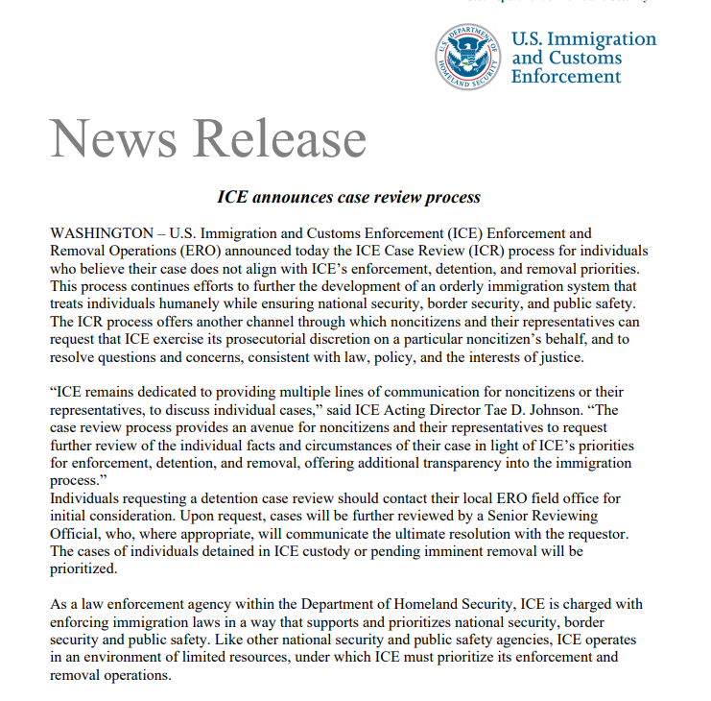
DHS CASE REVIEW PROCESS
Notes:
DEPARTMENT OF HOMELAND SECURITY CASE REVIEW PROCESS:
Contact ICE About an Immigration/Detention Case - The US Immigration and Customs Enforcement (ICE) has created an appeals process that will permit migrants to challenge arrests and deportations if they feel their treatment does not reflect the Biden administration’s own policies.
DHS reports that the appeals process could be used by individuals who believe that their case does not “align with ICE’s enforcement, detention, and removal priorities.”
Contact ICE About an Immigration/Detention Case at https://www.ice.gov/ICEcasereview for contact information (i.e., DHS field offices and contact information), guidance and forms available to support the case review process conducted by DHS.

Slide 17
DHS TRIGGERS FOR INFORMATION REGARDING CRIMINAL COURT PROCEEDINGS
Self-Reporting
immigration
application
forms
Detention
Referral
(i.e., fingerprinting)
interviews
at the border
DHS

Slide 18
ADVERSE IMMIGRATION CONSEQUENCES:
WHAT WE KNOW…
NOT ALWAYS IMMEDIATELY APPARENT
RANGES IN SEVERITY AND IMPACT
  Delay in adjudication of immigration applications;
  Denial of immigration benefits; and/or
  Referral to immigration court for removal from the U.S.
  If ordered removed, permanent expulsion from the U.S. is likely
NOTICE RECOMMENDED FOR “INFORMED” AND “VOLUNTARY” DECISIONS
DIFFERING RESPONSIBILITIES INVOLVED IN ADDRESSING ADVERSE IMMIGRATION CONSEQUENCES

Slide 19
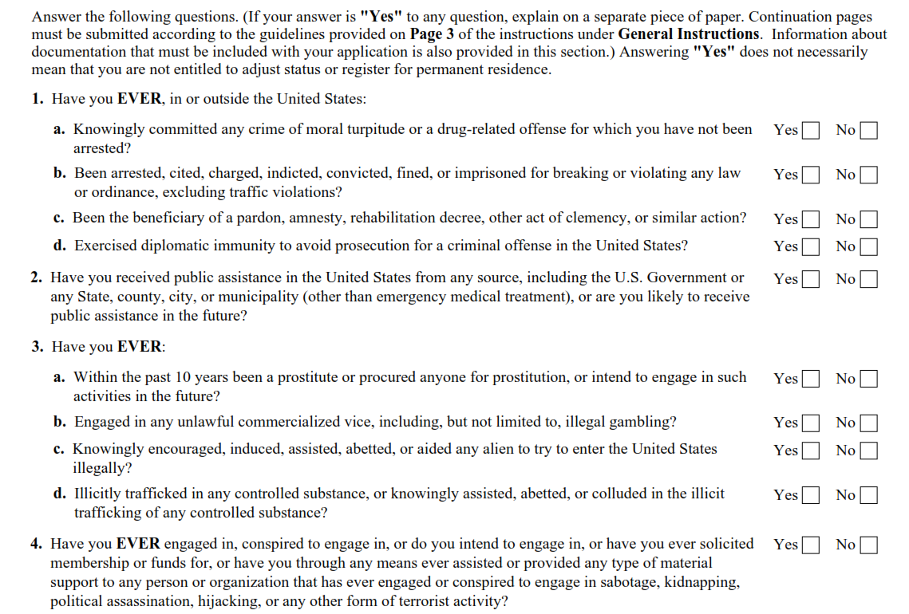
I-485, APPLICATION TO REGISTER PERMANENT RESIDENT OR ADJUST STATUS
Notes:
Example of the types of questions that an applicant seeking a green card (i.e., LPR status) must answer under penalty of perjury before DHS.

Slide 20
IMMIGRATION ENFORCEMENT?
Dept. of Homeland
Security
(Homeland Security
Act of 2002)
Citizenship and
Immigration
Services
(CIS)
Immigration and
Customs
Enforcement
(ICE)
Customs and
Border
Protection
(CBP)
Border Patrol
Affirmatively filed applications
(green card application,
naturalization, etc.)
Inspection upon returning
to the US following travel abroad
Encounter/referral during a
road block or LEA stop
Immigration Detainers
Notes:
Each of the above-referenced authorities within the umbrella of the US Department of Homeland Security have the authority to issue immigration charging documents to place an individual into immigration detention and before an immigration judge for a removal hearing.

Slide 21
IMMIGRATION COURT SYSTEM
US DEPARTMENT OF JUSTICE
US FEDERAL COURTS
(US district Courts and Circuit Courts of Appeal)
BOARD OF IMMIGRATION APPEALS
(immigration administrative appeals)
EXECUTIVE OFFICE FOR IMMIGRATION REVIEW
(immigration courts)
Department of Justice
Civil Division
Office of Immigration Litigation (OILS)
(Assistant US Attorneys)
Department of Homeland Security
Office of Chief Counsel
(Assistant Chief Counsel)
DHS Office
Of Chief
Counsel
(prosecution)
Notes:
Sample of structure for the immigration removal hearing process.

Slide 22
EFFECTIVE COUNSEL
Padilla v. Commonwealth of Kentucky 559 U.S. 356, 130 S.Ct. 1473 (2010)
[R]ecent changes in our have made removal nearly an automatic result for a broad class of noncitizen offenders.” immigration law
6th Amendment guarantee of effective assistance requires defense counsel to provide affirmative, competent advice to a noncitizen defendant regarding the immigration consequences of a guilty plea.
Missouri v. Frye, 132 S. Ct. 1399 (2012) and
Lafler v. Cooper, No. 10-209 (March 21, 2012)
6th Amendment right to effective assistance of defense counsel at plea bargaining stage

Slide 23
Life After Padilla:
Defending In Criminal Court
Unique nature of deportation is “particularly severe penalty” that is intimately tied to criminal process and therefore advice regarding deportation is not removed from the ambit of the Sixth Amendment right to effective assistance of counsel.
Padilla v. Kentucky, 130 S.Ct. 1473, 1481 (2010)
Silence on the issue of immigration consequences is “at odds with the critical obligation of counsel...”
Padilla v. Kentucky, 130 S.Ct. at 1484

Slide 24
Life After Padilla:
Defending In Criminal Court
Preserving the client’s right to remain in the U.S. may be more important to the client than any potential jail sentence.
Padilla v. Kentucky, 130 S.Ct. at 1483 (citing INS v. St. Cyr, 533 U.S. 289, 323, 121 S.Ct. 2271, 150 L.Ed.2d 347 (2001))
Professional norms (standards) for defense lawyers provide the guiding principles for what constitutes effective assistance of counsel – relying on principles that require a defense counsel to determine citizenship/immigration status of a client and to investigate and advise on immigration consequences.
Id. at 1483-1484
The Court endorsed “informed consideration” of deportation consequences by both the defense and the prosecution during plea-bargaining.
Id. at 1486
Notes:
Post-Padilla Case of Interest: Federal
Kovacs v. U.S., 744 F.3d 44 (2d Cir. Mar. 3, 2014) (petitioner demonstrated reasonable probability that he could have negotiated a plea that did not affect his immigration status, and demonstrated reasonable probability that he would have proceeded to trial if he had known the truth).

Slide 25
Post-Padilla Cases: NYS
Attorney “opinion”:
“may be deported” not found ineffective
People v. Marino-Affaitati, 930 N.Y.S.2d 77, (N.Y.A.D. 2 Dept., 2011)
“bigger fish to fry” not found ineffective
People v. Glasgow, 943 N.Y.S.2d 674, (N.Y.A.D. 3 Dept., 2012)
People v. Obeya, Docket No. 105313 (N.Y.A.D. 3 Dept., 10/31/13)
Erroneous reliance on “interview sheets” of another attorney found not to be ineffective:
People v. Carty, 2012 WL 2034991, (N.Y.A.D. 3 Dept., 2012)
Immigration misadvice:
(i.e., appeal will avoid deportation) found ineffective
People v. Reynoso, 931 N.Y.S.2d 430, (N.Y.A.D. 3 Dept., 2011)
Issue Not For Direct Appeal:
People v. Salmon, 2012 WL 2580015, (N.Y.A.D. 2 Dept., 2012); People v. Ramnaraine, 938 N.Y.S.2d 465, (N.Y.A.D. 2 Dept., 2012); People v. Romero, 918 N.Y.S.2d 730, (N.Y.A.D. 2 Dept., 2011)
Notes:
Post-Padilla Cases of Interest: New York State
People v. Lantigua, 184 AD3d 80 (1st Dept) (4/30/20 DOI). Error to summarily deny CPL 440.10 motion regarding IAC as to advice on immigration consequences. In unsworn letter, counsel admitted his flawed performance. The defendant received no relevant advice at the plea proceedings. The motion court should not have focused on likelihood that the defendant would have been convicted after trial. IAC claim may succeed even where a favorable outcome is unlikely. The defendant faced only a short sentence if convicted after trial and he had family here.
People v. George, 183 AD3d 436 (1st Dept), (5/15/20 DOI). The defendant’s guilty plea subjected him to mandatory deportation. His 440 motion charged that defense counsel was ineffective in failing to make any effort to negotiate a plea with less severe immigration consequences. Plea counsel did not consider immigration impact, according to a supporting affidavit. Where the alleged IAC was the failure to negotiate an immigration-friendly plea, the defendant must show a reasonable probability that the People would have made such an offer. The defendant made such showing. Motion court abused its discretion in denying the 440 motion without a hearing.
People v. Ni, 184 AD3d 541 (COA) (6/25/20 DOI). The defendant was convicted, after a jury trial, of 3rd
degree grand larceny and other crimes. In a 440 motion, he asserted that his attorney advised him that a guilty plea to petit larceny would result in mandatory deportation. In fact, such a plea would only have rendered the defendant deportable with the possibility of discretionary relief. The defendant claimed that he rejected a favorable plea offer based on the misadvice. A hearing was necessary to determine whether counsel gave erroneous guidance and the defendant was thereby prejudiced.
People v. Gomez, 186 AD3d 422 (1st Dept), (8/14/20 DOI). Direct appeal raising IAC claim. Affirmance. One judge dissented. At the plea hearing, the court asked, “do we have any Padilla issue here?” Defense counsel responded that he had spoken to the defendant “about all possible consequences.” The defendant then pleaded guilty to the crime, an aggravated felony. The consequences were not “possible,” but virtually certain. The majority failed to explain why this case was not governed by many previous decisions holding that the court could review an IAC claim where counsel represented that he advised the client of possible immigration consequences when the defendant, in fact, faced mandatory deportation.

Slide 26

People v. Picca, 2012 WL 2016397, N.Y.A.D. 2 Dept.,2012
“to require that defendants apprehend the relevance of their noncitizenship status, and affirmatively provide this information to counsel, would undermine the protection that the Padilla Court sought to provide to noncitizen defendants.”
Notes:
Note: People v Picca places the burden on defense counsel to inquire as to the immigration status of a client as part of affirmative duty to advise on immigration consequences.

Slide 27
Affirmative Advice &
The Strickland Standard
The Court expressly rejected option of limiting application of Strickland v. Washington 466 U.S. 668 (1984) to claims of affirmative misadvice:
“ A holding limited to affirmative misadvice…would give counsel an incentive to remain silent on matters of great importance…when answers are readily available.”
Id. at 1484
Notes:
Application of Strickland, recent case:
Doe v. United States, No. 17-1841 (2d Cir. 2019) - Cooperating Witness Writ of Coram Nobis Based on Failure of Trial Counsel to Accurately Advise of Immigration Consequences
In Doe v. Unites States, the Second Circuit (Chief Judge Katzmann, Judge Kearse, and Judge Chin) reversed the district court’s denial of Doe’s petition for a writ of coram nobis. In a partially redacted opinion, the panel recognized the right of a defendant to make plea decisions with knowledge about the immigration consequences. Specifically, Doe, an LPR (green card holder) cooperated with the government following a guilty plea to a conspiracy offense. Although the offense was an aggravated felony, Doe’s attorney assured him that he should not be subject to removal and the government offered assurances that they would prevent any deportation. Doe was placed into removal proceedings and subsequently sought a coram nobis petition. Initially the government opposed the petition but then retracted their opposition in support of Doe’s requested relief arguing that Doe had received ineffective assistance of counsel.
Examining the evidence from the time of Doe’s plea, the Court concluded that Doe had been “deeply concerned” about the deportation consequences that might attach to his plea, and he had received multiple reassurances from his counsel and the government that his plea would not lead to his removal. The Court also found that Doe’s background indicated deep ties to the United States and a clear desire to remain. The Court rejected the government’s argument that there was not another clear option for Doe to plead guilty, stating that he could have pleaded to the same offense with a lower-dollar loss amount, which would not have led to the offense being classified as an aggravated felony, or to a different, redacted offense. And further, while the Court noted that Doe did have available defenses at trial, it also noted that, where the consequences of conviction after trial were not significantly more severe, it might be rational to pursue “even a small possibility of an acquittal or a successful challenge to the loss figure.”

Slide 28
Emerging Issues
Notes:
SECTION HEADER
28

Slide 29
COURT OBLIGATION: JUDICIAL NOTIFICATION OF IMMIGRATION CONSEQUENCES
“To protect the rights of a large number of non-citizen defendants pleading guilty to felonies in New York, trial courts must now make all defendants aware that, if they are not United States citizens, their felony guilty pleas may expose them to deportation.”
Short, straightforward statement – advising of potential consequence and encouraging consultation with defense attorney about deportation
People v. Peque, 22 NY3d 168, 176 (2013); People v. Diaz (2012) (remanded); People v. Thomas (2011)(affirmed) Nov. 19, 2013. See also, People v. Suazo, 32 NY3d 491, 499-500 (2018).

Slide 30
Does a judicial notification cure prejudice from a Padilla violation?
The roles and responsibilities of court and counsel are legally and practically distinct – Knowing and voluntary pleas do not overcome ineffective assistance by defense counsel. Lafler v. Cooper, 132 S.Ct. 1376, 1390 (2012) (“An inquiry into whether the rejection of a plea is knowing and voluntary, however, is not the correct means by which to address a claim of ineffective assistance of counsel.”) Only defense counsel is aware of the specific factors in a defendant’s case, including relevant consequences and goals.
See ABA Pleas of Guilty Standard 14-3.2; see also ABA Pleas of Guilty Standard 14-3.2(f) cmt. at 126 (“[O]nly defense counsel is in a position to ensure that the defendant is aware of the full range of consequences that may apply in his or her case.”)

Slide 31
Does a judicial notification cure prejudice from a Padilla violation?
Counsel failed to negotiate – If the prejudice inquiry turns on whether the court provided a judicial notification, counsel was already ineffective for failing to negotiate effectively. Missouri v. Frye, 566 US 134, 144 (2012) (“Criminal defendants require effective counsel during plea negotiations. Anything less… might deny a defendant effective representation by counsel at the only stage when legal aid and advice would help him.”) (citations omitted)

Slide 32
Does a judicial notification cure prejudice from a Padilla violation?
Is the advisal “correct advice”? – use of the word “may” isn’t accurate when the non-citizen is pleading guilty to an offense that requires mandatory deportation or deportation with no possibility of relief from removal.
Full scope of professional obligations for attorneys includes more than just deportability: inadmissibility, naturalization, relief eligibility, etc.
Notes:
People v. Delorbe 35 NY3d 112, (March 31, 2020). Defendant pleaded guilty to attempted second-degree burglary eight months after being provided a written notice indicating that his guilty plea may result in adverse immigration consequences, including removal, (i.e., theft-related offense qualified as aggravated felony under 8 USC § 1101(a)(43)). He was sentenced to 5 years in prison and filed a pro se CPL 440.10 motion, asserting that defense counsel failed to inform regarding his risk of removal. The narrow preservation exception under Peque was inapplicable, as defendant had the opportunity to raise the issue previously. A defendant must preserve a challenge to the voluntariness of a plea and a due process violation claim stemming from the court failing to appraise the defendant in this regard. This is generally done through a motion to withdraw the plea prior to sentence (CPL 220.60(3)) or a motion to vacate the judgment after sentence (CPL 440.10). In this case, the record seems to indicate that defendant had actual knowledge of his immigration problem since he was handed a written notice at arraignment that gave the defendant the opportunity to ask questions regarding the immigration consequences of his guilty plea. The defendant’s direct appeal and his CPL 440 appeal were consolidated and his 440 motion denied.

Slide 33
A judge’s role
Provide all defendants with a brief, concise statement advising that a guilty plea may expose them to deportation or other immigration consequences.
Consider mitigating factors and/or requests made to minimize immigration consequences.
Provide defense counsel with an opportunity to consult with an immigration expert.
Make defendant aware that defense attorney has an obligation to advise on immigration consequences without inquiring into defendant’s status.

Slide 34
Duties of Defense Counsel
Provide accurate and complete advice
Negotiate effectively with district attorney
Analyze immigration consequences with immigration
attorney
Determine client’s immigration status, background and goals

Slide 35
IMMIGRATION CONSEQUENCES
IN CRIMINAL PROCEEDINGS
Notes:
SECTION HEADER

Slide 36
DEFENSE PROTOCOL:
WHAT DEFENSE ATTORNEYS NEED TO KNOW!
  CITIZENSHIP or NATIONALITY
  IMMIGRATION STATUS
  MANNER OF ENTRY and LENGTH OF TIME in the U.S. (i.e., first and last trip into the U.S.)
  Any PRIOR CRIMINAL HISTORY and IMMIGRATION HISTORY
  Any “IMMEDIATE FAMILY” in the U.S.

Slide 37
DEPORTABILITY v. INADMISSIBILITY
INA § 237, 8 U.S.C. § 1227 INA § 212, 8 U.S.C. § 1182
Technically:
  Deportability applies to non-citizens whom the government has “admitted” into the United States (e.g. LPRs, refugees)
  Inadmissibility applies to those seeking lawful admission or permanent residency status (e.g. undocumented, visa overstays applying for permanent residency, LPRs applying for admission)
Practically:
  Each set of rules, or both, may apply to the same person in various situations

Slide 38
ARE MINOR OFFENSES A PROBLEM?
OFTEN NO IMMIGRATION CONSEQUENCE | *TRIGGERS IMMIGRATION CONSEQUENCE
DISORDERLY CONDUCT NYPL §240.20 | UNLAWFUL POSSESSION OF MARIJUANA NYPL §221.05
LOITERING NYPL §240.35 | APPEARANCE IN PUBLIC UNDER THE INFLUENCE OF NARCOTICS OR A DRUG OTHER THAN ALCOHOL NYPL §240.40
TRESPASS NYPL §140.05 | THEFT OF SERVICES (turnstile jumping) NYPL §165.15(3)
UNLAWFULLY POSTING ADVERTISEMENTS NYPL §145.30 | LOITERING FOR THE PURPOSE OF ENGAGING IN A PROSTITUTION OFFENSE NYPL §240.37
FAILING TO RESPOND TO AN APPEARANCE TICKET NYPL §215.58

Slide 39
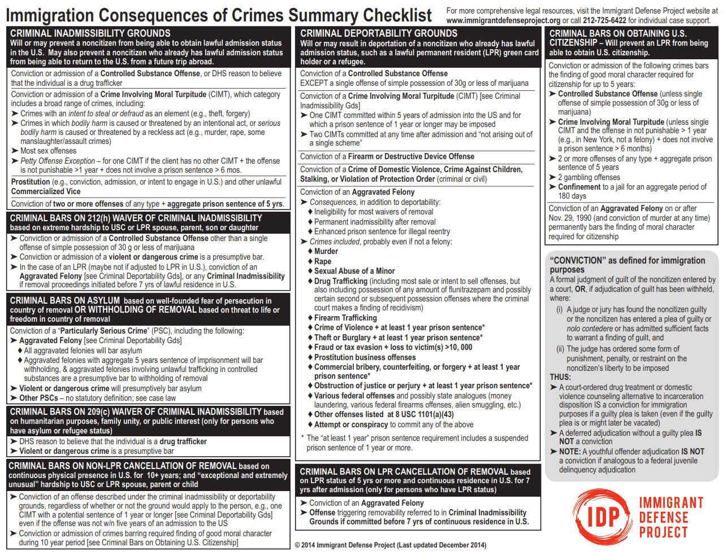

Slide 40

AGGRAVATED FELONIES
    Loss of lawful permanent residency
    Permanent ineligibility for citizenship
    Mandatory detention without bond
    Permanent bar to return after deportation
    Increased sentence enhancements for illegal re-entry prosecutions under 8 U.S.C.§1326
    Cuts off almost all defenses to removal and relief
    Deportation is almost certain!
Notes:
NOTED CASES OF AGGRAVATED FELONY OFFENSES:
*Sexual Abuse of a Minor – Esquivel-Quintana v. Sessions, 137 S.Ct. 1562 (2017). The Supreme Court rejected the BIA’s interpretation of sexual abuse of a minor, “hold[ing] that in the context of statutory rape offenses focused solely on the age of the participants, the generic federal definition of ‘sexual abuse of a minor’ under §1101(a)(43)(A) requires the age of the victim to be less than 16.”
**Arson and Explosives – Torres v. Lynch, 136 S.Ct. 1619 (2016). Holding “a state crime counts as an aggravated felony when it corresponds to the specified federal offense in all ways but one – namely the […] the interstate commerce element” where state crime at issue was NY crime of arson.
***Crime of Violence – Johnson v. United States, 576 U.S. ___ (2015) (June 26, 2015). The Supreme Court struck down ACCA’s residual clause as void.
***Crime of Violence – Sessions v. Dimaya, 138 S.Ct. 1204 (2018). Dimaya was charged in immigration court with 3 grounds of removal: (1) CIMT, (2) AF – theft, and (3) COV. The Supreme Court held that the residual clause of the federal “Crime of Violence” definition, found at 18 U.S.C. § 16(b), as incorporated in 8 U.S.C. § 1101(a)(43)(F), was impermissibly vague in violation of due process, hence Dimaya’s CA residential burglary convictions based on 16(b) were in effect nullified.
***Drug Trafficking/Moncrieffe/marijuana exception -- Moncrieffe v. Holder, 133 S. Ct. 1678 (2013) (see practice advisory in materials). (1) Distribute a small amount of marijuana. (2) No remuneration. (3) 21 USC § 844 no more than 1 year imprisonment, and (4) 18 USC § 3607 → eligible for probation and “shall not be considered a conviction.”
***Inchoate Crimes -- Conspiracy, Attempt, and Solicitation:
a. 8 USC §1101(a)(43)(U) – attempt and conspiracy to commit an aggravated felony (AF) = an AF.
b. If the underlying or substantive crime is a CIMT, then a conviction for aiding in the commission of the crime or otherwise acting as an accessory before the fact is also a CIMT. See Matter of Short, 20 I&N Dec. 136 (BIA 1989).
Aiding & Abetting:
a. Aider & abettor is treated as the Principal, per 18 USC §2.
b. AF note: While aiding and abetting is not included in §1101(a)(43)(U), it can be an aggravated felony where the underlying crimes is an aggravated felony. See Kawashima v. Holder, 132 S.Ct. 1166 (2012) (guilty plea to one count of aiding and assisting in the preparation of false tax returns is an AF under 8 USC §1101(a)(43)(M)(i)).

Slide 41
AGGRAVATED FELONIES
Conviction-
Based AFs
Conviction of Specified Offense
Sentence-Based AFs
Conviction of Specified Offense
&
Sentence of 1+ Yr
(now or VOP)
Circumstance-Specific AFs
Conviction of Specified Offense
&
Other Factor (e.g. > $10k loss of victim)

Slide 42
POINTS ABOUT AGGRAVATED FELONIES
Doesn’t need to be “aggravated”
Doesn’t need to be a felony (includes misdemeanors, and the government even argued NYS violations!)
Many offenses are aggravated felonies even if client received no jail time
Attempt and conspiracy to commit AF is also an AF
Immigration courts use the “categorical approach” to determine whether a state offense is an aggravated felony under federal law – this is a elements-based comparison, comparable to how NYS courts decide whether an out-of-state conviction is a predicate under NY law. More on this later.
Notes:
IMPORTANT NOTE:
Consider alternative felony misdemeanors to address concerns regarding the immigration consequences connected to the “aggravated felony” definition.
**See materials on listing of federal misdemeanors – NOTE: The misdemeanor offenses listed do include certain aggravated felonies (i.e., fraud-related misdemeanor if the loss is designated over $10,000).

Slide 43
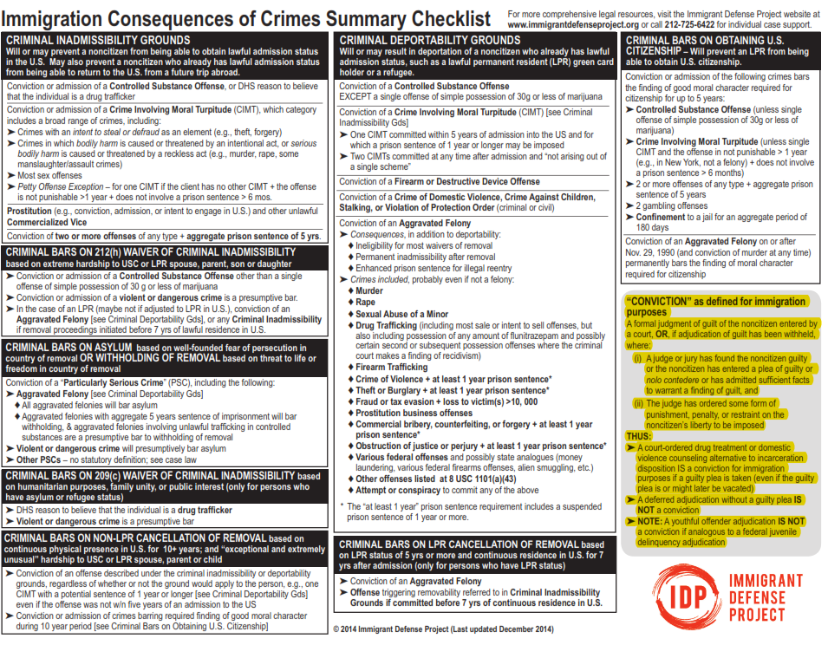
Crimes Involving Moral Turpitude
Vaguely defined in case law as a depraved or immoral act, intrinsically wrong (malum in se), or a violation of the basic duties owed to fellow man. In re Florez, 17 I&N Dec. 225 (BIA 1980).
Requires “vicious motive or corrupt mind” - mens rea of at least recklessness.
An offense with a mens rea of negligence is not a CIMT.
  Ex) Negligent Homicide, NYPL 120.10
Because the concept is so nebulous and the language of the statute matters, it often requires research into immigration and state case law
Notes:
Ramirez v. Sessions, 887 F.3d 693, 704 (4th Cir. 2018), as amended (June 7,
2018) (citations omitted). “The BIA defines the term ‘moral turpitude’ as behavior ‘that shocks the public conscience as being inherently base, vile, or depraved.’ A CIMT must involve
both a morally culpable mental state and morally reprehensible conduct. To meet
the mens rea requirement, the crime must have, as an element, an intent to
achieve an immoral result or willful disregard of an inherent and substantial risk
that an immoral act will occur. To meet the actus reus requirement, the crime
‘must involve conduct that not only violates a statute but also independently
violates a moral norm.’”
Linares-Gonzalez v. Lynch, 823 F.3d 508, 514 (9th Cir. 2016). Defines the federal definition of a crime involving moral turpitude as (1) fraud or (2) conduct that is (a) vile, base or depraved, and (b) violates accepted moral standards; holding that the CA identify theft statutes under which defendants were
convicted were not CIMTs.
Federal Examples of application of CIMT definition:
1. Misprision of a felony under 18 USC § 4, Villegas-Sarabia v. Sessions, 874 F.3d 871, 879 (5th Cir. 2017), cert. denied, 139 S. Ct. 320, 202 L. Ed. 2d 218 (2018). Discussing circuits where misprision is a CIMT and where it is not. See also Cert Petition for Villegas-Sarabia v. Sessions (noting the circuit split that in the 1st, 5th, and 11th Circuits, misprision is a CIMT but in 2nd, 9th, and 10th Circuits, it is not a CIMT).
2. CIMT: Theft under 18 U.S.C. § 656, See Matter of Batten, 11 I&N Dec. 271 (BIA 1965).
3. NOT A CIMT: Criminal violations of banking regulations – Goldeshtein v. INS, 8 F.3d 645 (11th Cir. 1993) (but deportable as an aggravated felony).
4. NOT A CIMT: Evading the draft – Matter of S, 5 I&N Dec. 425 (BIA 1953) but can be deportable on other immigration grounds.
5. NOT A CIMT: Illegal Re-entry – Rodriguez v. Campbell, 8 F.2d 983 (5th Cir. 1925) but deportable on Goldstein other immigration grounds
6. Failure to Register?
a. Yes - Willful Failure to Register as a Sex Offender under California Penal Code § 290(g)(1) is a CIMT because the statute requires willful violation – Matter of Tobar-Lobo, 24 I&N Dec.
143 (BIA 2007).
b. No - Failure to register as a Sex Offender under Minnesota Statute § 243.166 is not a CIMT because a person may be convicted based on forgetfulness. Totimeh v. Att’y Gen., 666 F.3d 109, 115 (3d Cir. 2012).

Slide 44
NYPL AND CIMTs
Minor New York offenses are routinely charged by the government as CIMTs:
  Theft of services (turnstile jumping), NYPL §165.15(3)
  Petit larceny (shoplifting), NYPL §155.25 (committed after 11/16/2016)
BUT some surprisingly MAY NOT be CIMTs so do NOT assume you know just by looking at the statute
  Resisting Arrest, NYPL § 205.30

Slide 45
CIMTs AND REMOVABILITY
Inadmissible if convicted of OR admit to having committed ONE CIMT, EXCEPT:
Petty Offense Exception, INA § 212(a)(2)(A)(ii)(II):
  Only one CIMT conviction;
  Maximum penalty possible does not exceed 1 year imprisonment; AND
  Client was not sentenced in excess of 6 months
Petty offense: In NY, one A misdemeanor CIMT w/sentence of 6 mos. or less
Deportable if convicted of:
ONE CIMT that was committed within 5 years of admission for which a sentence of a year or longer may be imposed* (INA § 237(a)(2)(A)(i))
TWO CIMTs at any time & not arising out of single scheme of criminal misconduct (INA § 237(a)(2)(A)(ii))
IN NY, one A misdemeanor CIMT committed within 5 years of admission or
Two CIMTs at any time if not “single scheme”
  *“Admission” is a term of art

Slide 46
Controlled Substance Offense (“CSO”)
“Controlled substance” refers to a substance that appears on the federal Controlled Substances Act, including marijuana.
Offenses that can trigger this deportability ground include:
  Simple possession;
  Possession with intent to sell or distribute;
  DUI if under the influence of a controlled substance;
  Paraphernalia offenses with a federal substance;
  Some medical fraud offenses.
Notes:
DRUG CRIMES PRACTICE TIPS
#1 PRACTICE TIP: Be Aware of Drug Paraphernalia
Barma v. Holder, 640 F.3d 749 (7th Cir. 2011), (drug statute applies to drug paraphernalia)
Mellouli v. Lynch, 135 S.Ct. 1980 (2015). Holding that a sock is not drug paraphernalia and “reject[ing] the argument that any drug offense renders an alien removable, without regard to the appearance of
the drug on a §802 schedule [defining controlled substance.]”
#2 PRACTICE TIP: OVERBROAD DRUG STATUTES
United States v. Reyes-Mendoza, 665 F.3d 165 (5th Cir. 2011). Reversing a sentenced under 2L1.2 based on a CA conviction that prohibited the manufacture of a controlled substance where the CA definition of “manufacture” was broader that drug trafficking offenses for purposes of 2L1.2
United States v. Townsend, 897 F.3d 66, 74 (2d Cir. 2018). Holding that a “controlled substance” in 4B1.2 refers exclusively to a substance controlled by the CSA and NY statute at issue was broader than CSA, where defendant could be convicted of selling HCG.
#3 PRACTICE TIP: DRUG CONDUCT could provide “REASON TO BELIEVE” (RTB) that the client is a drug trafficker making client inadmissible.
Cuevas v. Holder, 737 972, 975 (5th Cir. 2014). LPR entered the U.S. with a drug amount consistent with drug trafficking, but not convicted; court held the immigration authorities had reason to believe he was
drug trafficker.

Slide 47
CSO COMPARISON
INADMISSIBILITY
DEPORTABILITY
No exception
Possible waiver for: single “offense” of 30g or less involving marijuana for personal use
Also includes scenarios in which DHS has “reason to believe” that person is a drug trafficker, which can include dismissed charges
Exception: single “offense” involving 30g or less of marijuana for personal use

Slide 48
FIREARM OFFENSES
Inadmissibility
Deportability
Not ground of inadmissibility
May be also CIMT
  Firearm w/intent to use – NYPL § 265.01(2)
Removable for conviction for purchasing, selling, offering for sale, exchanging, using, owning, possessing, or carrying (or attempt or conspiracy) a firearm or destructive device. INA § 237(a)(2)(C).
  NYPL § 265.01(1) (if firearm)
Notes:
Example:
United States v. Aguilera-Rios, 769 F.3d 626, 637 (9th Cir. 2014). Holding that defendant’s conviction under a CA state law that allows a conviction for using antique firearms is not a firearms offense.

Slide 49
DOMESTIC VIOLENCE-RELATED GROUNDS OF DEPORTABILITY
Crime of Domestic Violence
Violators of Protection Orders
Requires a conviction
“Domestic violence” =
  crime of violence (18 U.S.C. § 16) +
  Against person protected by domestic laws of jurisdiction
Conviction in criminal court (e.g., criminal contempt, etc.);
OR
Finding of a violation of OOP by family court or other tribunal (no criminal conviction required)* (more on this later)
Notes:
IMPORTANT NOTE: For those practicing in NYS Family Court:
The “finding” of a violation of an order of protection involving an individual recognized under local, state or federal law as defined under “domestic violence” protection is a ground of deportation.

Slide 50
CRIMES AGAINST A CHILD
Includes offenses that are intentional, knowing, reckless and criminally negligent or involve an omission that constitutes maltreatment of a child under the age of 18 or impairs a child’s physical/mental well-being
Currently being litigated at Second Circuit: NYPL § 260.10 endangering the welfare of a child

Slide 51
CONDUCT-BASED FINDINGS THAT MAY BAR IMMIGRATION RELIEF
Prostitution (i.e., finding of engaging in sex for money within past 10 years is inadmissible) 8 USC § 1182(a)(2)(D)
Drug Trafficking (i.e., “reason to believe” of assisting in or drug trafficking is inadmissible but not deportable) 8 USC § 1182(a)(2)(C)
Drug Addict or Abuser (i.e., inadmissible if a “current” drug addict or abuser, and deportable if he/she has been one at any time since admission to the U.S. within the past 3 years) 8 USC §1182(a)(1)(A)(iii) (inadmissibility) and 8 USC §1227(a)(2)(B)(ii) (deportability)
Money Laundering (i.e. “reason to believe” laundering of monetary instruments is inadmissible) 8 USC § 1182(a)(2)(I), also an aggravated felony if amount > $10,000
“Admission” to committing a CIMT or CSO (or to acts constituting the “essential elements” of a CIMT or CSO) 8 USC § 1182(a)(2)(A)(i)

Slide 52
N-400, APPLICATION FOR NATURALIZATION
(p. 15 and 16 of 21)

Slide 53
I-485, APPLICATION TO REGISTER PERMANENT RESIDENT OR ADJUST STATUS
(p. 3)
Notes:
53

Slide 54
CRIMINAL IMMIGRATION TERMINOLOGY
Notes:
54

Slide 55
What is a “conviction?”
Removability usually requires “conviction”
  INA § 101(a)(48), 8 U.S.C. § 1101(a)(48)
A conviction is:
  A formal judgment of guilt entered by a court
      or
  Where adjudication of guilt has been withheld,
    Δ admits facts sufficient to warrant a finding of guilt
    and
    Court has ordered some form of punishment, penalty, or restraint on liberty.

Slide 56
WHICH NEW YORK DISPOSITIONS ARE “CONVICTIONS” ?
CONVICTION | NOT A CONVICTION
Formal judgment of guilt in adult criminal court (including NY Juvenile Offender conviction) | Youthful offender disposition (even though entered in adult court) and juvenile delinquency* dispositions (*BUT… possibly problematic “conduct” grounds)
Diversion, drug treatment or family counseling IF PLEA OR ADMISSION OF GUILT made by defendant, even if later vacated after successful completion | Diversion, drug treatment or family counseling IF PLEA OR ADMISSION OF GUILT WAIVED (i.e., NY CPL §216.05(4))
Conditional Discharge Sentence or Alford Plea | Adjournment in contemplation of dismissal (successful)
Post Conviction Relief/Motion pending on collateral challenge | Conviction on direct appeal or NYS late notice of appeal (460.30)
Disposition vacated/expunged in the “interest of justice” | Disposition vacated based on legal defect or constitutional violation in criminal case (i.e., NY CPL §440.10 motion)

Slide 57
What is a “sentence?”
INA § 101(a)(48)(B)
Suspended sentences, common in some other states, count
Resentencing counts
  If a client violates the terms of his/her probation, the time in custody imposed for that violation will be added to the original sentence and count towards the overall time considered for immigration purposes [Matter of Perez-Ramirez, 25 I&N Dec. 203 (BIA 2010)]
Notes:
57

Slide 58
VACATUR/SENTENCE REDUCTION
Conviction
Sentence
Order must reflect vacatur based, in part, on procedural or substantive defect in the original proceedings
Rehabilitative or “in the interest of justice” vacaturs not valid to avoid immigration consequences
If vacatur is valid, underlying charges may be dismissed “in the interest of justice”
Reduction or vacatur “in the interest of justice” recognized by the BIA

Slide 59
VACATUR OF A CONVICTION
Order must reflect vacatur based, in part, on procedural or substantive defect in the original proceedings
Rehabilitative or “in the interest of justice” vacaturs not valid to avoid immigration consequences or based on reasons of rehabilitation only.
If vacatur is valid, underlying charges may be dismissed “in the interest of justice”
Matter of Thomas, 27 I&N Dec. 674 (A.G. 2019), Int Dec 3966 (Oct 25, 2019)

Slide 60
(a brief overview of)
THE CATEGORICAL APPROACH
Notes:
60

Slide 61
What is the categorical approach?
The methodology for determining whether an offense triggers “conviction”-based immigration or federal sentencing consequences.
See Mathis at 2247, 2251, 2255 n.6; Moncrieffe at 1685.
Notes:
RECENT USSC DECISION TO NOTE:
On March 4, 2021, the Supreme Court issued Pereida v. Wilkinson, No. 19-438 (2021), a 5-32
opinion damaging to noncitizens with past criminal convictions who intend or need to seek relief
in removal proceedings. The decision creates a national rule concerning the impact of
inconclusive criminal court plea and conviction documents for noncitizens applying for relief
from removal in immigration proceedings, specifically in cases where the modified categorical
approach applies.
In Pereida the Court found that where a removable noncitizen is applying for relief from
removal and has a conviction under a multiple-offenses statute, the noncitizen has the burden of
proving the offense of conviction. Where the conviction is under a divisible statute and the
“record of conviction” documents before the adjudicator do not necessarily establish conviction
for a disqualifying crime, the Court ruled that the noncitizen cannot satisfy their burden of
proving relief eligibility by relying only on the inconclusiveness of that record. Rather, the
noncitizen must submit evidence to establish conviction of a non-disqualifying crime. Slip op. at
17.
Pereida reverses immigrant-favorable decisions on this issue in the First, Second, Third, and
Ninth Circuits: Sauceda v. Lynch, 819 F.3d 526 (1st Cir. 2016); Martinez v. Mukasey, 551 F.3d
113 (2d Cir. 2008); Thomas v. Att'y Gen., 625 F.3d 134 (3d Cir. 2010); Marinelarena v. Barr,
930 F.3d 1039 (9th Cir. 2019) (en banc) and affirms much of the reasoning and holdings in
immigrant-adverse decisions on this issue in the Fourth, Sixth, Eighth, and Tenth Circuits: Salem
v. Holder, 647 F.3d 111 (4th Cir. 2011); Gutierrez v. Sessions, 887 F.3d 770 (6th Cir. 2018);
Lucio-Rayos v. Sessions, 875 F.3d 573 (10th Cir. 2017).

Slide 62

How the categorical approach works:
a sequence of steps
Identify the “generic” definition of the immigration or federal sentencing provision.
Identify the “least-acts-criminalized” under the state statute of conviction.
Compare the elements of the statute of conviction with the elements of the generic offense.

Slide 63
If the state statute’s elements are broader than those of the generic crime, the conviction is categorically not a generic offense – the relevant removal statute does not apply.
ELEMENTS OF THE STATE STATUTE OF CONVICTION
ELEMENTS OF THE GENERIC OFFENSE

Slide 64
What about the modified categorical approach?
Where a statute covers “multiple crimes” and lists them as “elements in the alternative,” the statute is “divisible” and the adjudicator may apply the modified categorical approach “to determine what crime, with what elements, a defendant was convicted of.”
Mathis at 2249.

Slide 65
“Harbin” offenses
The Second Circuit found that the “controlled substance” element in certain P.L. 220 offenses was not divisible under the categorical approach, and because New York has non-federally controlled substances, those offenses are categorically not controlled substance offenses. Harbin v. Sessions, 860 F.3d 58 (2d Cir. 2017).
  NYPL § 220.31
  NYPL § 220.06(1)
  NYPL § 220.03
Notes:
65

Slide 66
Circumstance-specific approach
Matter of H. Estrada, 26 I&N Dec. 749 (BIA 2016) -- domestic nature of offense under “crime of domestic violence” deportability provision, INA 237(a)(2)(E)(i).
Nijhawan v. Holder, 557 U.S. 29 (2009) – loss amount for fraud aggravated felony provision at INA 101(a)(43)(M)(i)

Slide 67
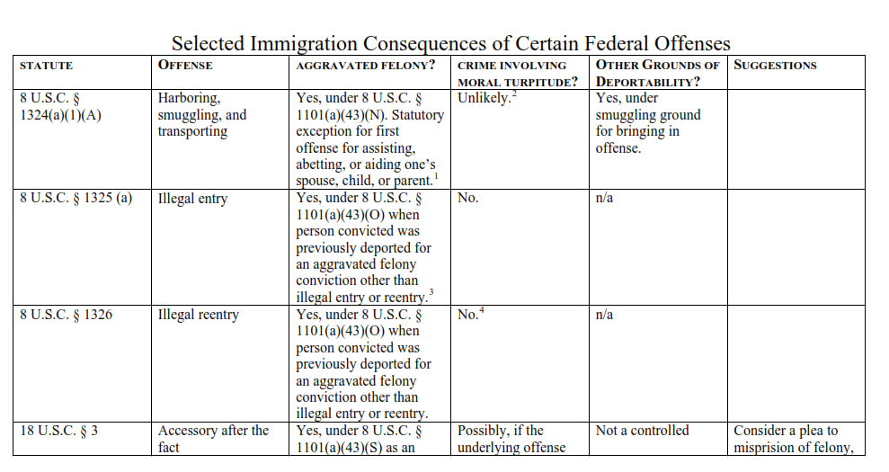
CRIMINAL LAW RESOURCE
National Immigration Project of the National Lawyers Guild: Selected Immigration Consequences of Certain Federal Offenses, https://defgen.vermont.gov/sites/defgen/files/Research/fed_chart_updated_Aug_05.pdf

Slide 68
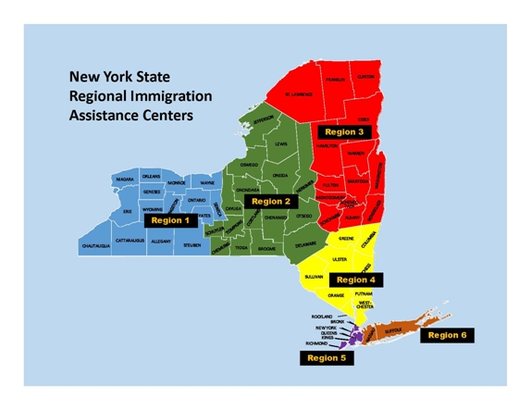
REGIONAL IMMIGRATION ASSISTANCE CENTERS
Region #4: Mid-Hudson
Legal Aid Society of Westchester County
150 Grand Street, 1st Floor
White Plains, New York 10601
P: (914) 286-3400
Region #5: New York City
Immigrant Defense Project
40 W 39th Street, 5th Floor
New York, New York 10018
P: (212) 725-6422
Region #6: Long Island
Legal Aid Society of Suffolk County
Cohalan Court Complex
400 Carleton Ave., 4th Floor
Central Islip, NY 11722
P: (631) 853-7770 → Suffolk County
P: (516) 560.6400 → Nassau County
Region #1: Western New York
Erie County Bar/Volunteer Lawyers’ Project
237 Main Street, Suite 1000
Buffalo, New York 14203
P: (716) 847-0662
Region #2: Central New York
Oneida County Courthouse
302 N. James Street
Rome, New York 13440
P: (315) 356-5794
Region #3: Capital District & Northern NY
112 State Street, Suite 720
Albany, New York 12207
P: (518) 447-4890

